Slide 1

Phishing URL Detection: A Machine Learning Approach

Slide 2





Meet the Team
Project Objective
Develop a machine learning-based phishing URL detector to enhance cybersecurity.
Aggrey Timbwa
Richard Macharia
Pamela Jepkorir Chebii
Cynthia Njambi
Goal:
Achieve real-time, high-accuracy phishing detection to protect users and businesses.

Slide 3
What is Phishing?
Deceptive Tactics
Real-World Examples
Fraudsters use email, social media, and other online channels to trick users into revealing sensitive information.
Emails impersonating banks, government agencies, and trusted brands are common phishing techniques.

Slide 4

Understanding Phishing Attacks
Business Risks
Financial losses
reputational damage.
Cybercrime
Sophistication
Advanced tactics
Social engineering.
Protection Necessity
Tools to identify phishing URLs for real-time detection.
1
2
3

Slide 5




Business Objectives
High-Accuracy Detection
User-Friendly Deployment
Real-Time Classification

Slide 6

Expected Impact
1
Financial Security
2
User Trust
Reduce financial losses due to phishing scams.
Build confidence in online interactions.

Slide 7

Benefits to Stakeholders
Business Users Helps secure business operations by preventing phishing scams, protecting financial data, and ensuring safe online transactions. Example is banking services.
Individual Users (General Public) Provides an easy way to avoid phishing attacks and safeguard personal information while browsing the internet.
Cybersecurity Teams Supports proactive threat prevention by identifying phishing URLs and integrating into existing security measures.

Slide 8
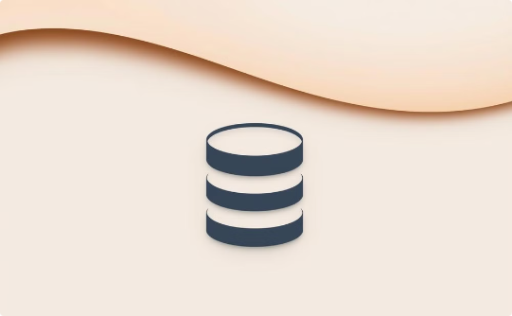


Data Foundation
Dataset
Size
Preparation
Mendeley Phishing URL Dataset.
6,568,184 URLs, reduced to 10,000 for analysis.
Feature extraction, cleaning, and encoding were performed.

Slide 9
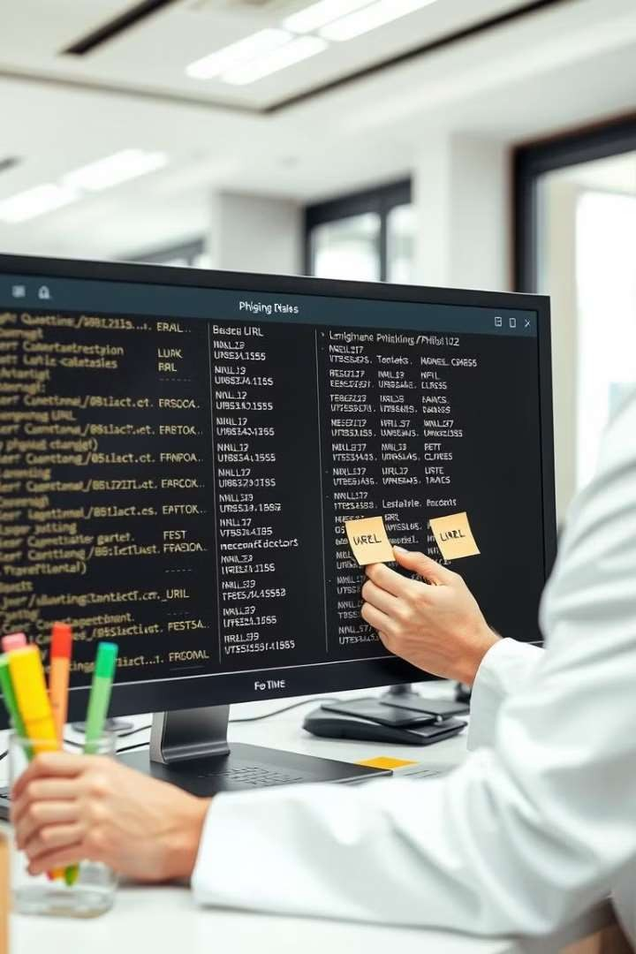
Data Preparation
Data Collection
Gather diverse labelled URLs from Mendeley Dataset .
1
Data Loading
Loaded the txt data into dataframes
2
Feature Extraction and Engineering
Extract 45 relevant URL attributes like domain age, URL length, Whois registration
3
.

Slide 10
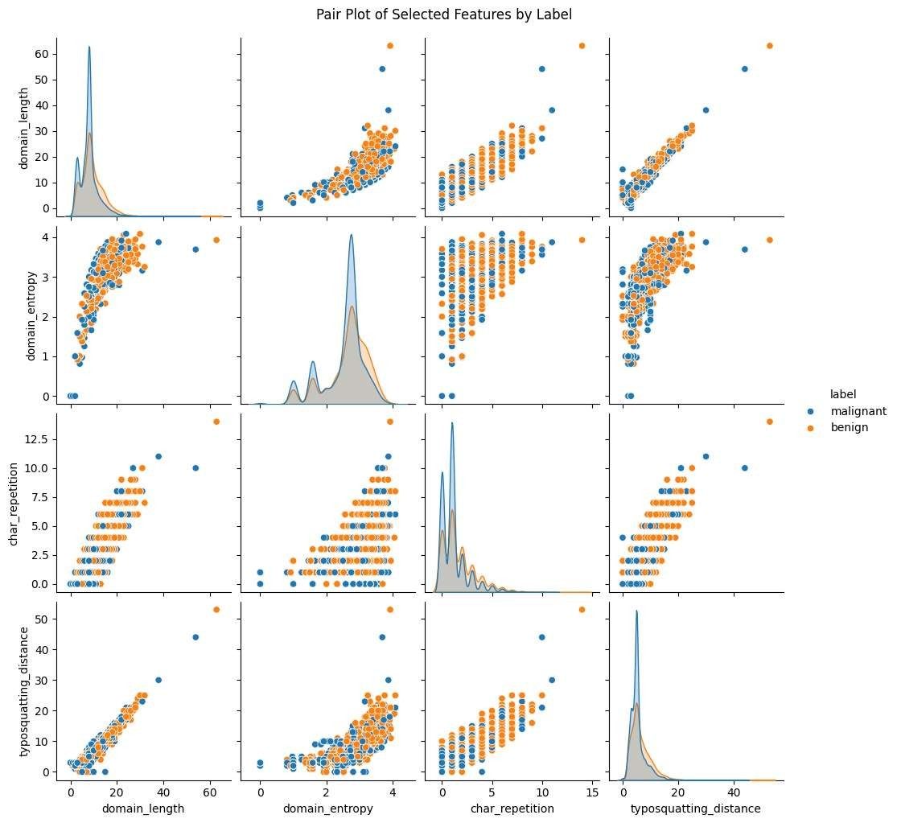
Select Feature Distribution
Distinct Distributions:
Some features show clear differences between benign and malignant labels.
Class Separation:
Features like domain length and typosquatting distance aid in distinguishing classes.
Significant Features:
Domain length, entropy, and character repetition stand out for classification.

Slide 11
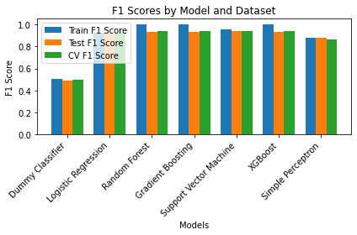
Methodology and Modeling
Iterative approach optimizing precision and recall using F1-scores.
Used pipelines to make preprocessing and modeling more seamless.
Incorporated hyperparameter tuning and PCA keeping 95% of the variance which reduced noise and boosted model performance
Best performing models included SVM followed by random forest and boosted models.

Slide 12
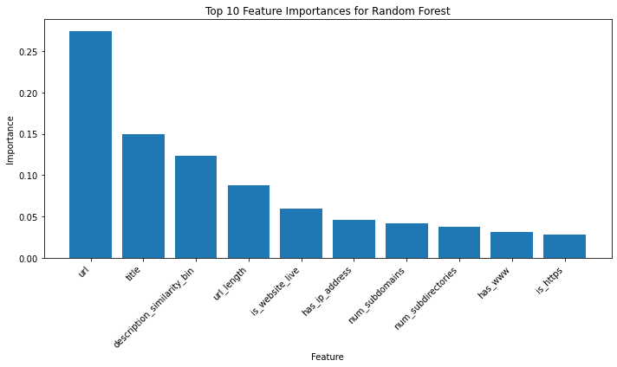
Most Important Features
URL was the most important feature across boosted models and random forests.
Models seemed to have picked up more patterns from the URLs themselves and our extracted features
Further feature extraction and engineering would likely improve the models’ generalizability and balance precision and recall.

Slide 13
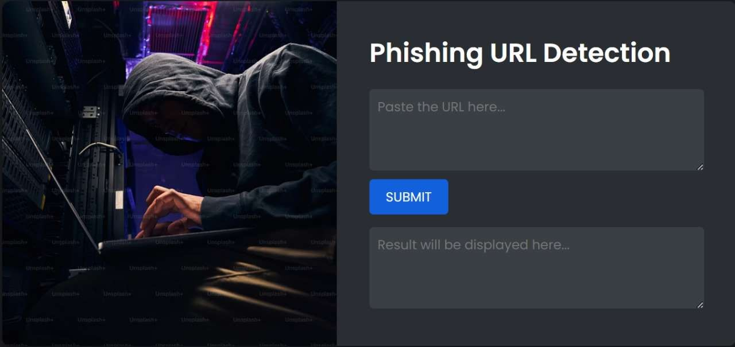
Deploying the Detector

Slide 14




Key Insights
Better URL description
Additional feature engineering could help the model learn more patterns from urls rather than from the urls themselves.
Hyperparameter Tuning
Tuning hyperparameters enhanced discrimination between phishing and legitimate URLs, improving overall F1 scores.
PCA Application
Helped reduce noise and improved model stability especially for complex models like Gradient Boosting and XGBoost.

Slide 15

Challenges and Next Steps
1
Compute Constraints
Scaling to large datasets.
2
Data Augmentation
Gather additional training data.
3
Browser Extension
Remove human in the loop for true real time detection
4
User Feedback
Collect user feedback for improvements.

Slide 16
Technology Stack
Python
Scikit-learn
Core programming language.
Machine learning library.
Pandas
Matplotlib
Data manipulation and analysis.
Data visualization library.
Flask
Render
Deployment of a web-based tool
Hosting web application

Slide 17

Conclusion
High-Accuracy Phishing Detection.
Balanced F1-Score
User-Friendly Web Deployment
Real-Time Classification
Identify Important Features

Slide 18

Q&A

Slide 19

Thank You

